Slide 1

Automated Tax Form Data Extraction Pipeline Using Google Cloud AI
Achilles Joaquin Zubia
05-28-2026

Slide 2
Project Objectives
01
02
Extract Customer Fields using Google Document AI
Parse and validate extracted values using Python
03
04
Store structured results in BigQuery
Export reviewed results into CSV format
05
Route incomplete or uncertain records for manual review

Slide 3
Dataset
The files are dummy U.S. tax forms and include both clean and noisy/scanned documents.
The PDFs were stored in Google Cloud Storage under the raw/ folder and processed through the extraction pipeline.
For evaluation, a manually checked ground truth sample was created from 27 PDFs:
11 clean PDFs
16 noisy PDFs
81 total field checks
4 fields marked as Not Verifiable

Slide 4
Dataset
Files:
dummy U.S. tax forms
(both clean and noisy documents)
PDFs were stored in Google Cloud Storage and processed through the extraction pipeline.
Evaluation: manually checked ground truth samples (27 PDFs):
11 clean PDFs
16 noisy PDFs
81 total field checks
4 fields marked as Not Verifiable

Slide 5
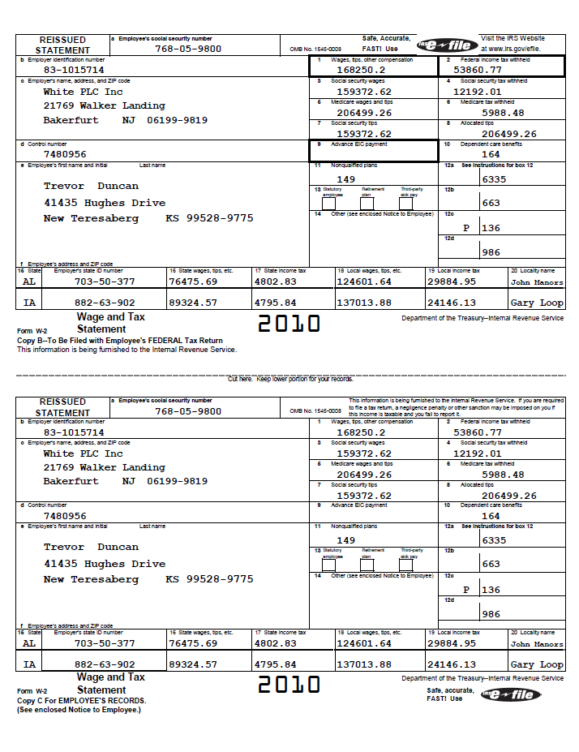
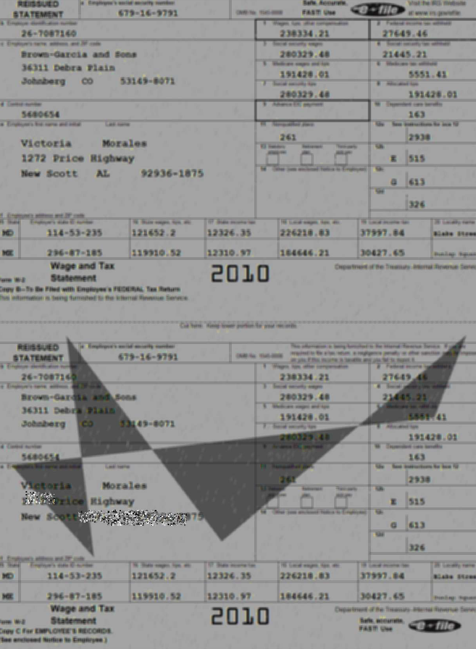
Dataset
clean
with noise

Slide 6
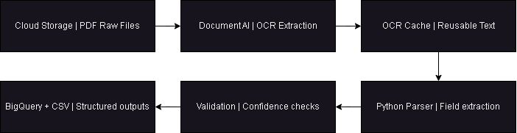
Pipeline Architecture

Slide 7
Extraction
Document AI extracts OCR text from each PDF.
Python parser identifies:
Employee / customer name
Employee / customer address
Employee / customer identification number
Employer name and address
Employer EIN
Validation
Validation checks:
Name format
Address completeness
ID number format
Confidence thresholds
Missing or uncertain fields
Status Output
AUTO_APPROVED
Complete and reliable fields
NEEDS_REVIEW
Missing, incomplete, or uncertain fields

Slide 8
Accuracy and Evaluation Results
Field-Level Accuracy
88.31%
Clean PDF Accuracy
87.88%
Noisy PDF Accuracy
88.64%
Auto-Approval Precision
100.00%
Evaluation was based on 27 manually checked PDFs with 81 field-level checks. Fields marked as Not Verifiable were excluded from the accuracy calculation.
Accuracy = Pass / (Pass + Fail)
68 / (68 + 9) = 88.31%

Slide 9
Full Dataset Processing Summary
Total PDFs Processed
481 / 481
Auto-Approved
258
53.64%
Needs Review
223
46.36%
Failed
0
0.00%
Processing Performance
Avg. Processing Time: 19.56s / PDF
Total Processing Time: ~ 2.61 hours
(9,408.36 total seconds)
Dataset Composition
Clean PDFs: 401
Noisy PDFs: 80

Slide 10

Strategic Business Impact
Operational Efficiency
Reduces manual reading and encoding of tax form PDFs through automated AI ingestion.
258
Auto-approved
223
Manual Review
0
Failed Files
Data Readiness
Creates structured CSV and BigQuery outputs enabling immediate downstream reporting and BI.

Slide 11

Limitations & Future Vision
Current Limitations
Future Improvements
Very noisy, rotated, or cut-off PDFs may still need manual review
OCR quality affects extraction accuracy
Address extraction is harder because it requires street, city, state, and ZIP
Validation is intentionally strict to avoid false auto-approval
Add layout-aware extraction for better field positioning
Add human-in-the-loop review dashboard
Improve noisy PDF handling with visual fallback models
Integrate approved records directly into a CRM workflow
Add monitoring dashboard for processing status and accuracy
The system is designed to automate reliable records while safely routing uncertain records for review.

